Slide 1
Deep Neural Networks
(AIML ZG511)

Slide 2
For queries related to Assignment communicate with Dr Sameera K M
km.sameera@wilp.bits-pilani.ac.in
MODULE # 6 :
CNN & Rewind
Session 8
(14th June,2026)

Slide 3
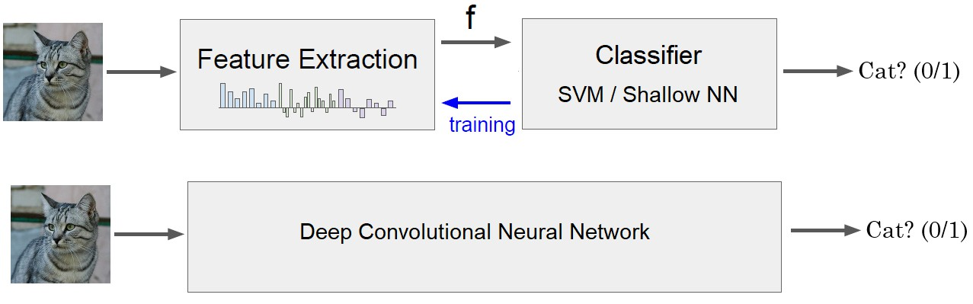
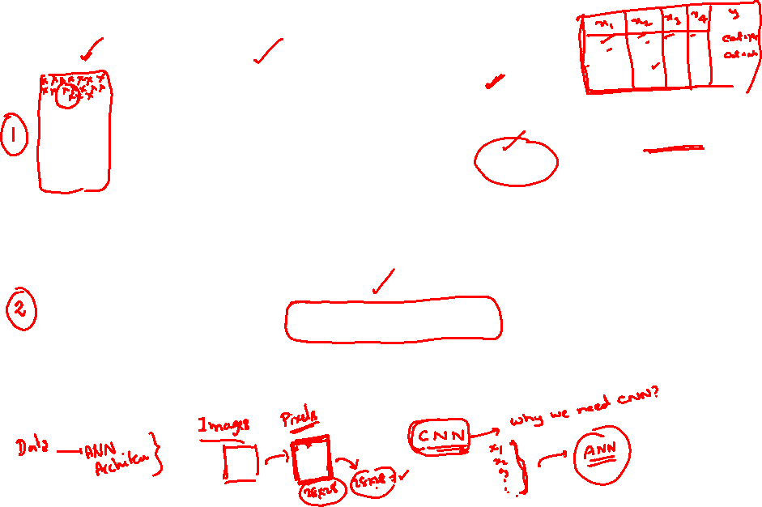
Image Classification - Solution

Slide 4
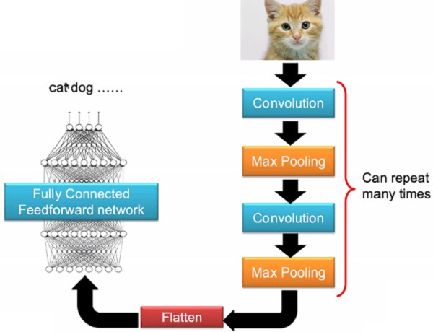
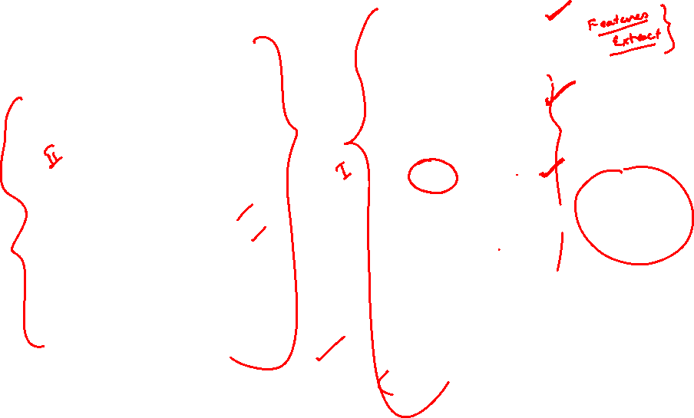
The Whole CNN

Slide 5

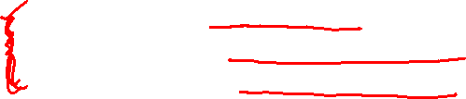
Hierarchical Feature Learning
Deep networks learn increasingly complex features:
Edges Corners Colors
Textures
Patterns
parts
Objects
Faces
Scenes
Low-level features
Mid-level features
High-level features
Example: Face Detection
Layer 1: Detects edges at various orientations
Layer 2: Combines edges into facial features (eyes, nose, mouth)
Layer 3: Combines features into complete face

Slide 6
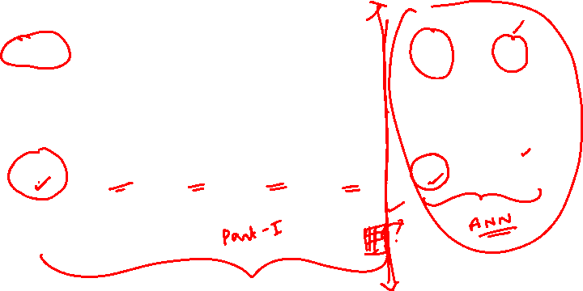
CNN Architecture
Architecture Pattern
INPUT → [CONV → ACTIVATION → POOL] x N → FC → OUTPUT
32×32×3
28×28×6
14×14×6
10×10×16
5×5×16
120
10
Input
Conv1
Pool1
Conv2
Pool2
FC
Output

Slide 7
CNN - Layer-by-Layer Breakdown
Early Layers (1-2)
Purpose: Detect low-level features
Features: Edges, corners, lines Filters: Small (3×3, 5×5)
Receptive Field: Local, small regions
Middle Layers (3-4)
Purpose: Combine low-level features
Features: Shapes, textures, patterns
Complexity: Medium-level abstractions
Receptive Field: textcolorBitsRedr regions

Slide 8
CNN - Layer-by-Layer Breakdown
Deep Layers (5+)
Purpose: Detect object parts
Features: Wheels, faces, eyes, ears
Complexity: High-level semantics
Receptive Field: textcolor Bits Red image regions
Fully Connected Layers
Purpose: Final classification decision
Input: Feature vector from conv layers
Output: Class probability scores
Function: Combine all learned features

Slide 9
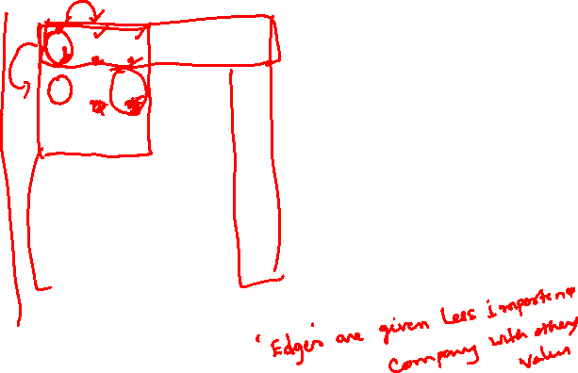
Convolution Operation
stride s = 1
After sliding through the entire image.
3 -1 -3 -1
-3 -1 0 -3
-3 -2 0 1
3 -2 -2 -1
Output Feature Map
1 | 0 | 0 | 0 | 0 | 1
0 | 1 | 0 | 0 | 1 | 0
0 | 0 | 1 | 1 | 0 | 0
1 | 0 | 0 | 0 | 1 | 0
0 | 1 | 0 | 0 | 1 | 0
0 | 0 | 1 | 0 | 1 | 0
1 | -1 | -1
-1 | 1 | -1
-1 | -1 | 1
Filter 1
Input Image 6 × 6

Slide 10
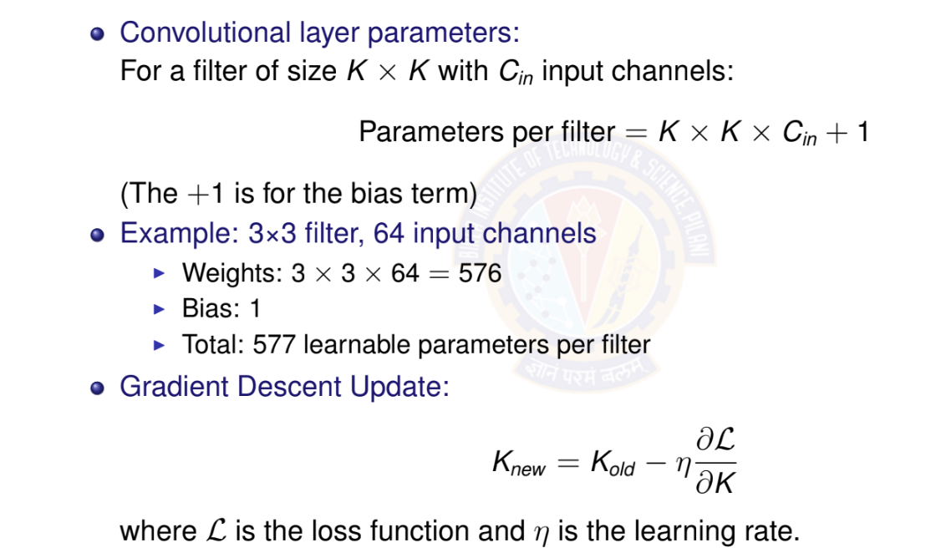
Kernels as Parameters

Slide 11
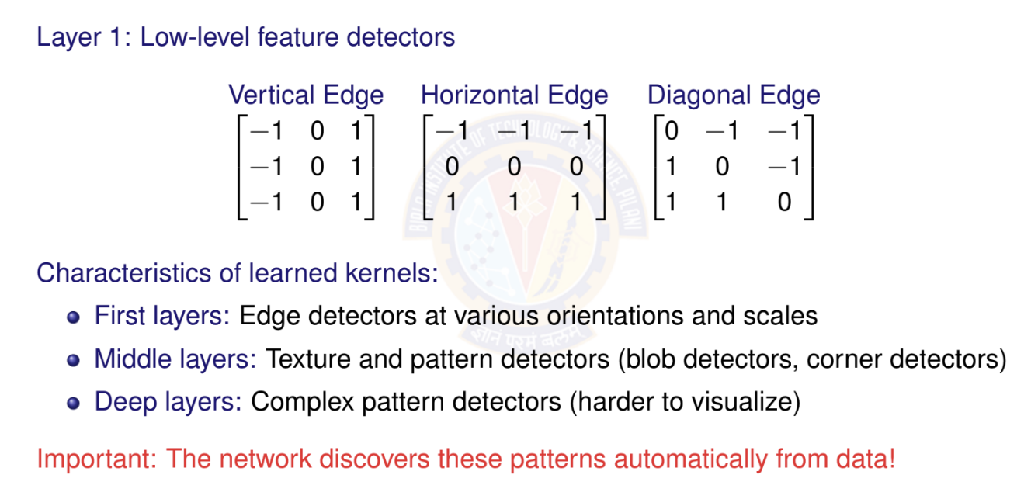
What Do Learned Kernels Look Like?

Slide 12
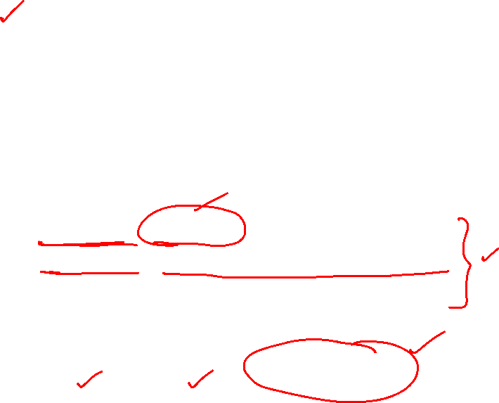
Padding
Why Padding?
Without padding: Output size = Input size - Kernel size + 1
Information at borders gets less attention
Deep networks would shrink feature maps rapidly
Types of Padding
Valid Padding: No padding (output smaller than input)
Same Padding: Pad to keep output size = input size
Full Padding: Maximum padding
Same Padding Calculation
For kernel size k and stride s = 1: Padding = (k — 1)/2

Slide 13
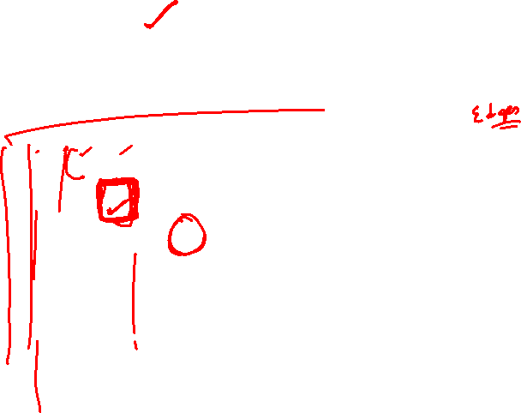
Convolution with Padding
Input Image with padding 8 × 8
0 | 0 | 0 | 0 | 0 | 0 | 0 | 0
0 | 1 | 0 | 0 | 0 | 0 | 1 | 0
0 | 0 | 1 | 0 | 0 | 1 | 0 | 0
0 | 0 | 0 | 1 | 1 | 0 | 0 | 0
0 | 1 | 0 | 0 | 0 | 1 | 0 | 0
0 | 0 | 1 | 0 | 0 | 1 | 0 | 0
0 | 0 | 0 | 1 | 0 | 1 | 0 | 0
0 | 0 | 0 | 0 | 0 | 0 | 0 | 0
Filter1
*
1 | -1 | -1
-1 | 1 | -1
-1 | -1 | 1

Slide 14
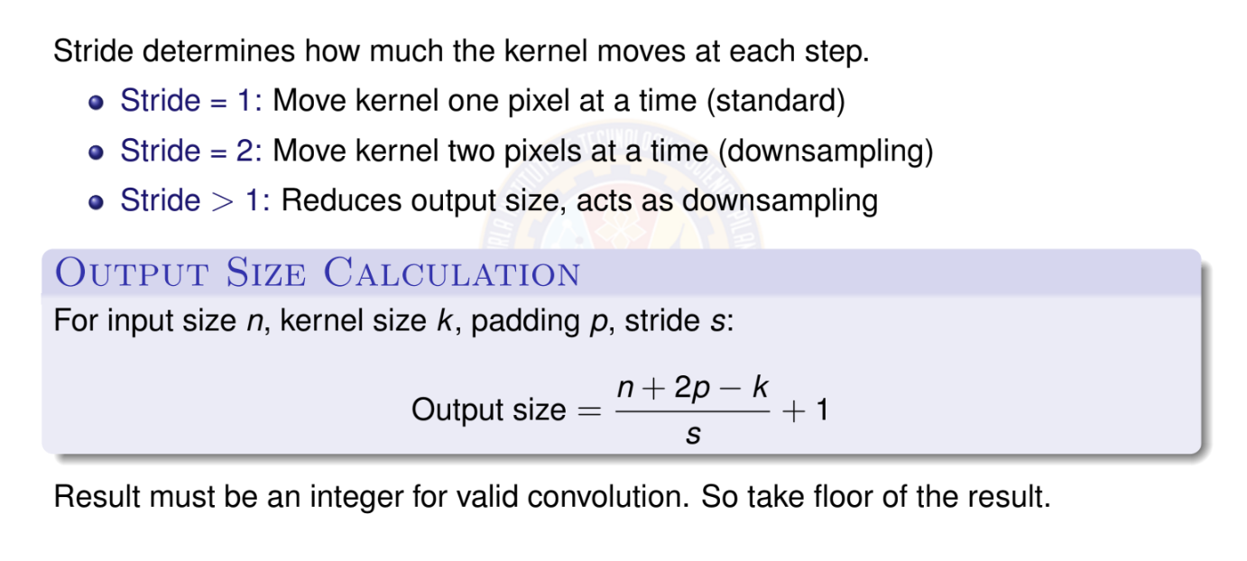
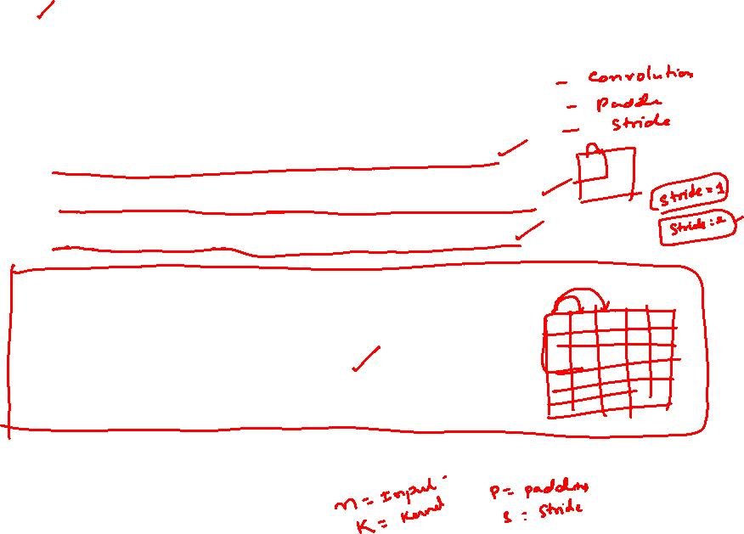
Stride

Slide 15
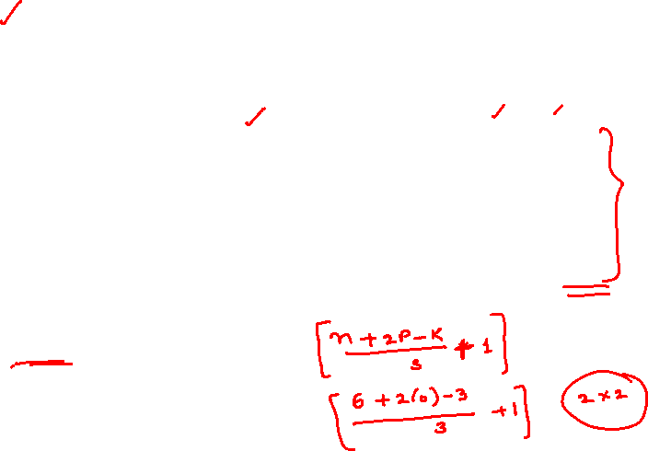
Convolution Operation with Stride
stride s = 3
1 | 0 | 0 | 0 | 0 | 1
0 | 1 | 0 | 0 | 1 | 0
0 | 0 | 1 | 1 | 0 | 0
1 | 0 | 0 | 0 | 1 | 0
0 | 1 | 0 | 0 | 1 | 0
0 | 0 | 1 | 0 | 1 | 0
1 | -1 | -1
-1 | 1 | -1
-1 | -1 | 1
3 -1
3 -1
Feature Map 2x2
Filter1
Input Image 6 × 6

Slide 16
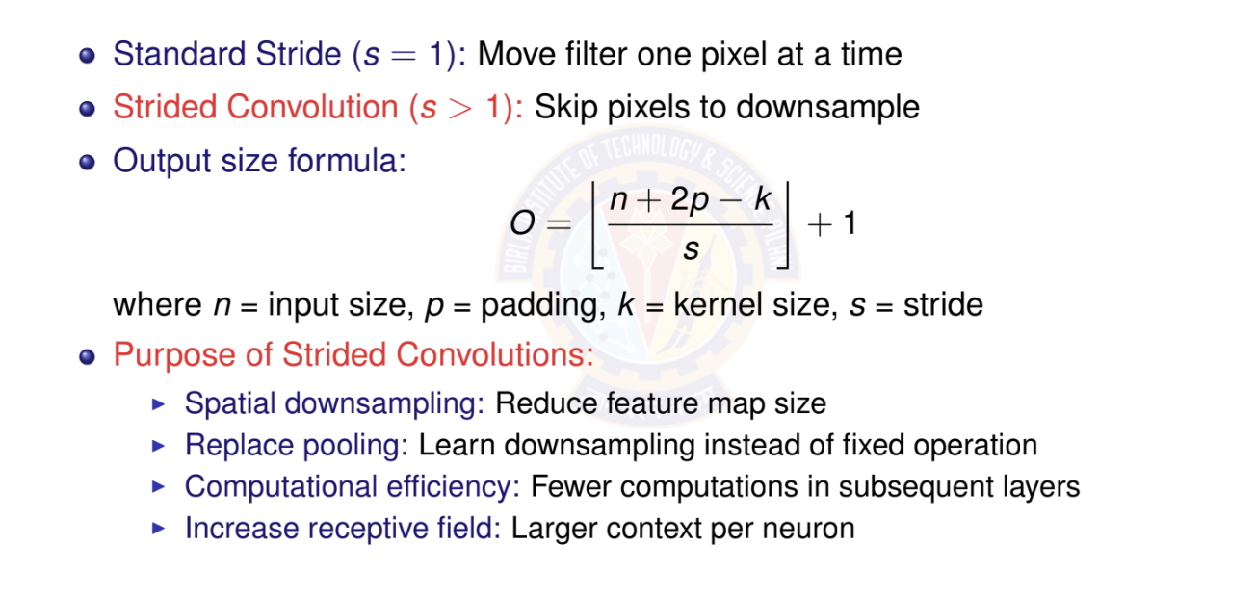
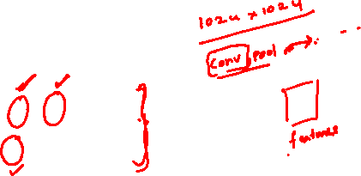
Strided Convolution

Slide 17
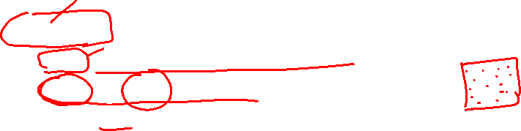
Dilated (Atrous) Convolution
Definition
Dilated convolution (also called atrous convolution) inserts spaces (holes) between kernel elements to increase receptive field without increasing parameters.
Dilation rate r : Number of pixels between kernel elements
r = 1: Standard convolution (no dilation)
r = 2: One pixel gap between kernel elements
r = 3: Two pixel gaps between elements
Effective receptive field:
k_{eff} = k + (k — 1)(r — 1)
where k = kernel size, r = dilation rate
Example: 3 × 3 kernel with r = 2 effective 5 × 5 receptive field

Slide 18

Dilated Convolution: Visual Example
Standard vs. Dilated Convolution
Standard (r = 1)
Dilated (r = 2)
Receptive field: 3 × 3
Receptive field: 5 × 5
Key Advantage: Same number of parameters (9), but larger receptive field!

Slide 19
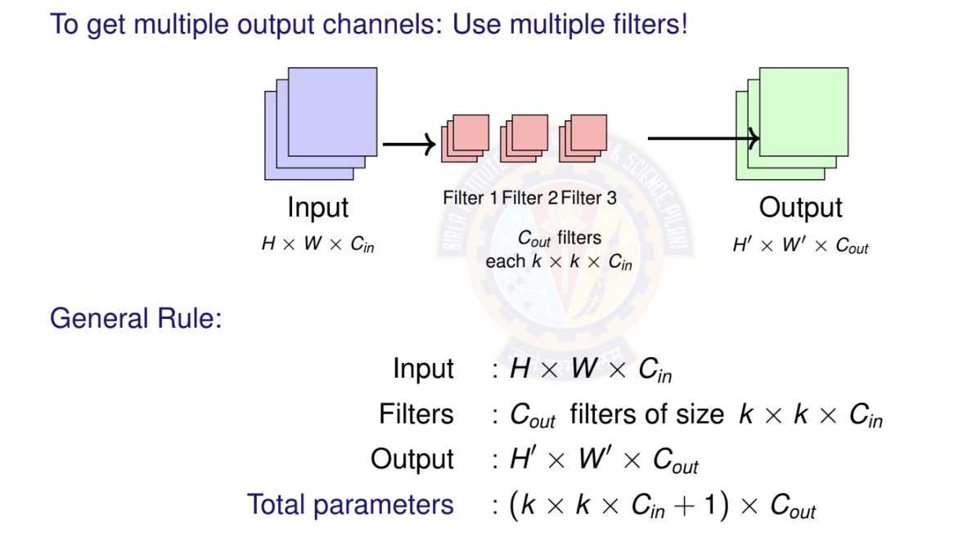
Multi-Channel Input and Output

Slide 20
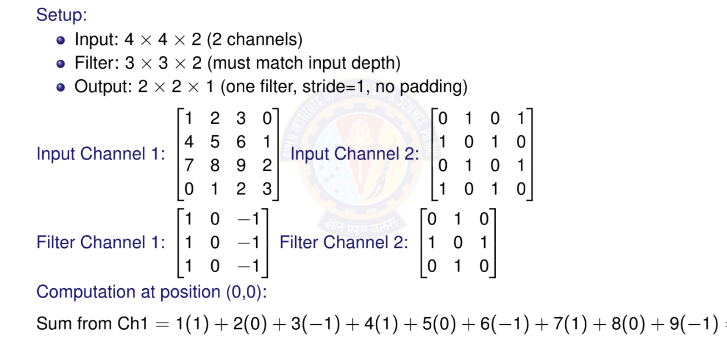
Multi-Channel Example: Numerical

Slide 21
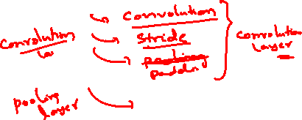
Pooling Operations
What Pooling Layers Do
Spatial Downsampling: Reduce height and width dimensions but preserve channel depth.
Translation Invariance: Make features less sensitive to small shifts.
Computational Efficiency: Reduce number of computations in subsequent layers.
Overfitting Reduction: Act as a form of regularization.
Pooling layers are parameter-free but still important for network performance
Global Average Pooling (GAP) is used to replace fully connected layers.
Two types
Max pooling
Average pooling

Slide 22
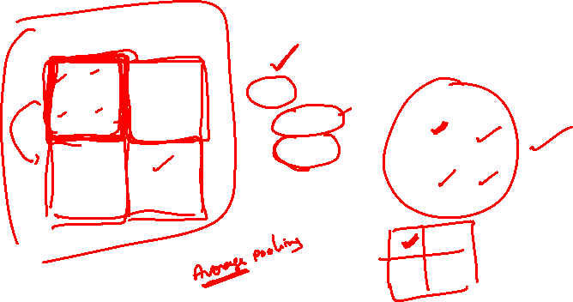
Max Pooling
Takes maximum value in each region Most common pooling operation Preserves strongest activations
output = max(inputs in window)
Input 4 × 4
Output 2 × 2
2 | 4 | 7 | 4
6 | 6 | 9 | 8
3 | 4 | 8 | 3
7 | 5 | 3 | 6
Max pooling
k = 2
s = 2
→
→
6 | 9
7 | 8

Slide 23
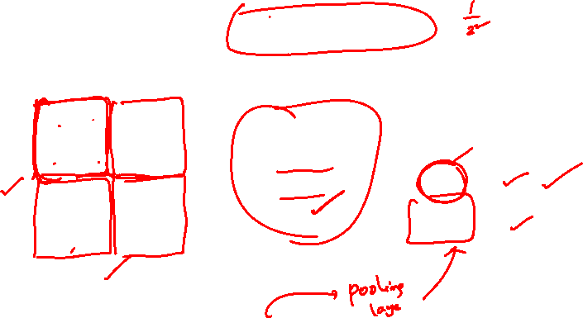
Average Pooling
Takes average of values in region
Smoother downsampling
Used in final layers sometimes
output = ¹ (inputs in window)
_{k} 2
Input 4 × 4
Output 2 × 2
2 | 4 | 7 | 4
6 | 6 | 9 | 8
3 | 4 | 8 | 3
7 | 5 | 3 | 6
Average pooling
k = 2
s = 2
→
→
4.5 | 7
4.75 | 5

Slide 24
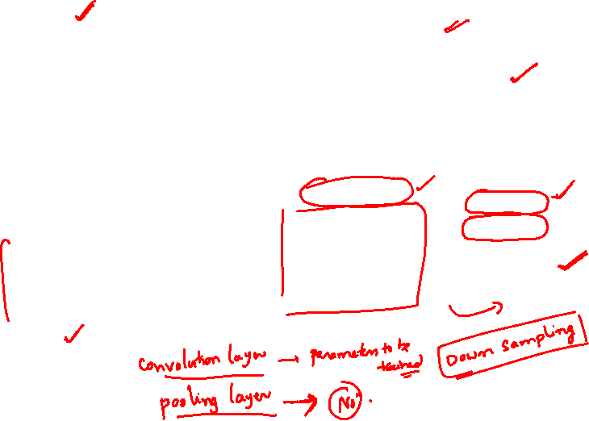
Convolution + ReLu + Max Pooling
Input Image 6 × 6
Convolve, s=1
1 | 0 | 0 | 0 | 0 | 1
0 | 1 | 0 | 0 | 1 | 0
0 | 0 | 1 | 1 | 0 | 0
1 | 0 | 0 | 0 | 1 | 0
0 | 1 | 0 | 0 | 1 | 0
0 | 0 | 1 | 0 | 1 | 0
-1 | -1 | -1 | -1
-1 | -1 | -2 | -1
-1 | -1 | -2 | 1
-1 | 0 | -4 | 3
Apply ReLU
Maxpool k=2, s=2
Filter
0 | 0 | 0 | 0
0 | 0 | 0 | 0
0 | 0 | 0 | 1
0 | 0 | 0 | 3
-1 | 1 | -1
-1 | 1 | -1
-1 | 1 | -1
0 | 0
0 | 3

Slide 25
Fully Connected (Dense) Layer
Definition
A Fully Connected (FC) Layer or Dense Layer is a layer where every neuron is connected to every neuron in the previous layer, performing a linear transformation followed by an activation function.
Role in CNN Architecture
Feature Flattening: Convert spatial features to vector:
(H × W × C) → (H · W · C)
Classification Head: Map features to class scores Dimensionality Control: Adjust feature vector size
Non-linear Mapping: Learn complex decision boundaries Typical CNN Flow:
Conv Layers → Flatten → FC Layer(s) → Output

Slide 26
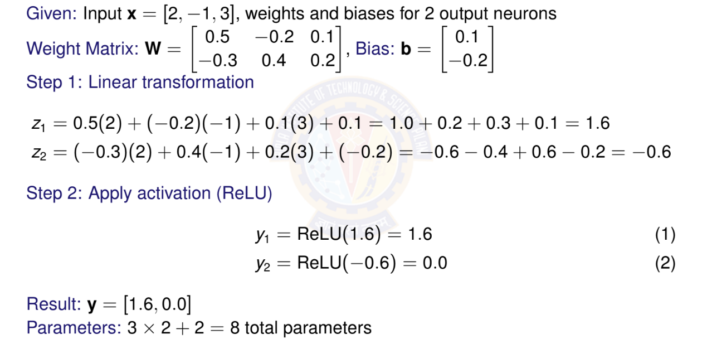
FC Layer - Numerical Example

Slide 27
Typical CNN Architecture
32×32×3
28×28×6
14×14×6
10×10×16
5×5×16
120
10
Input
Conv1 Pool1 Conv2 Pool2 FC
Output
Pattern: CONV → POOL →CONV →POOL →FC →OUTPUT
Early layers: Detect low-level features (edges, corners) Middle layers: Combine features (shapes, textures) Later layers: High-level concepts (objects, faces) Spatial size decreases, depth increases

Slide 28
Number of Parameters in Pooling Layers
Key Insight
Pooling layers have ZERO learnable parameters!
Why Zero Parameters?
Pooling operations are fixed mathematical functions: max or average
No weights or biases to learn
Only hyperparameters: pool size k and stride s

Slide 29

(a) Given an input matrix of size 8×8 and a kernel size of 3×3 with a stride of 1 and no padding, determine the output shape after applying the convolution operation.
(b) If there are 5 such filters applied, what will be the output shape?
(c) Apply a 4×4 max-pooling filter with a stride of 2 to the output from part (b). What will be the final output shape?
(a) n = 8
f = 3
s = 1
Output dimension = { (8 + 2.0 – 3)/1} + 1
= 6 x 6
b) Since there are 5 such filters , the number of output channels will be 5.
Out put dimension = 6 x 6 x 5
c) Output dimension = {(6 – 4) / 2} + 1
= 2
= 2 x 2 x 5

Slide 30
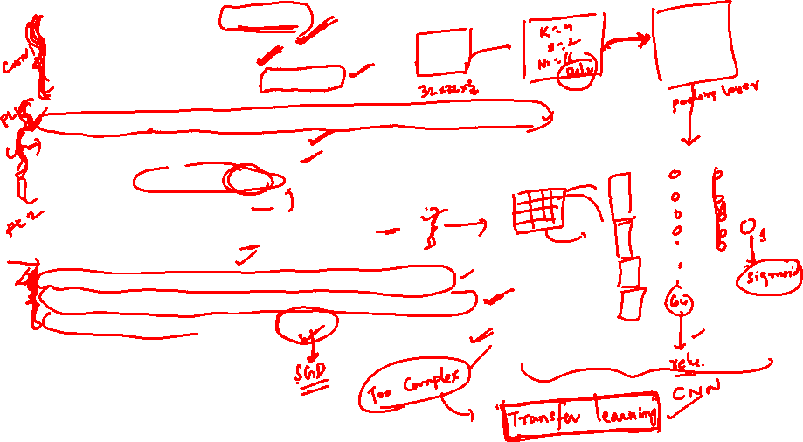

Slide 31
Revision

Slide 32
Learning Problems
Supervised Learning
  Training by examples
  The model is given a dataset which has the data and its labels
  Eg: Classification, Regression
  You will learn this in this course and Machine Learning Course
Unsupervised Learning
  Situations where we feed the model a giant dataset containing only the features
  Eg: Clustering, Generate synthetic data (uses GAN)
  You will learn this in Advanced Deep Learning Course and Machine Learning Course
Reinforcement Learning
  Develop an agent that interacts with an environment and takes actions over a series of time steps.
  You will learn this in Deep Reinforcement Learning Course
Notes:
GAN – generative adversarial networks
Supervised learning is explained in the subsequent slides.
Reinforcement Learning is out of scope of this course.

Slide 33
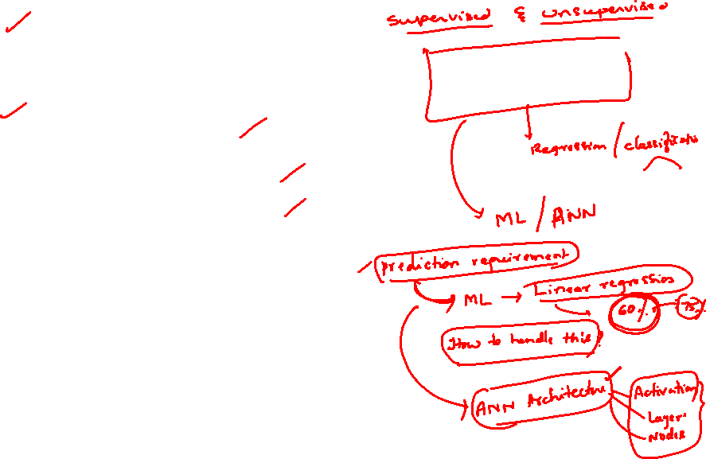
Supervised Learning Tasks
Regression
  how much or how many question
Classification
  Binary classification
  Multi-class classification
  Multi-label classification
Recommender systems
Sequence Learning
  Tagging and Parsing
  Automatic speech recognition
  Text to speech
  Machine translation

Slide 34
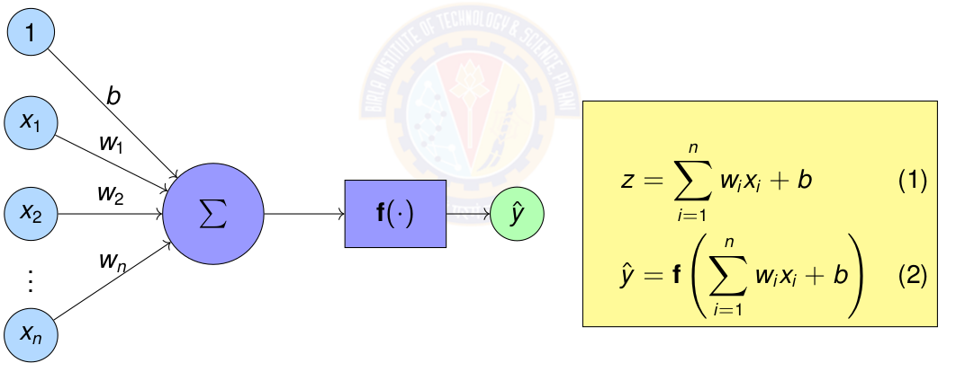
Artificial Neuron – Mathematical Computation
Sum of weights w_{i} times corresponding features x_{i}
Apply activation function f () on the sum.

Slide 35
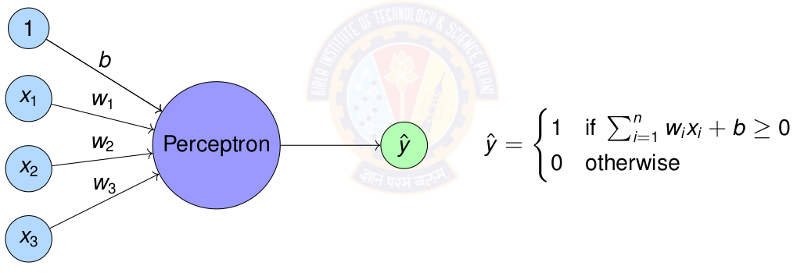
Perceptron
Perceptron = Simplest form of artificial neuron

Slide 36
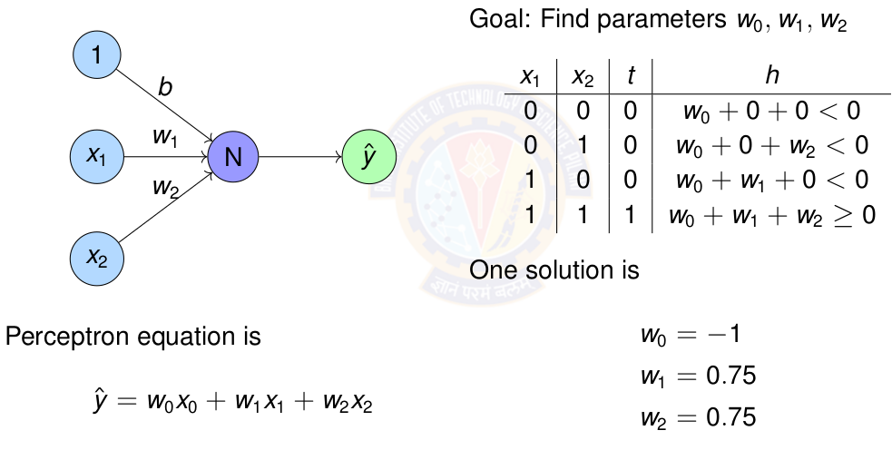
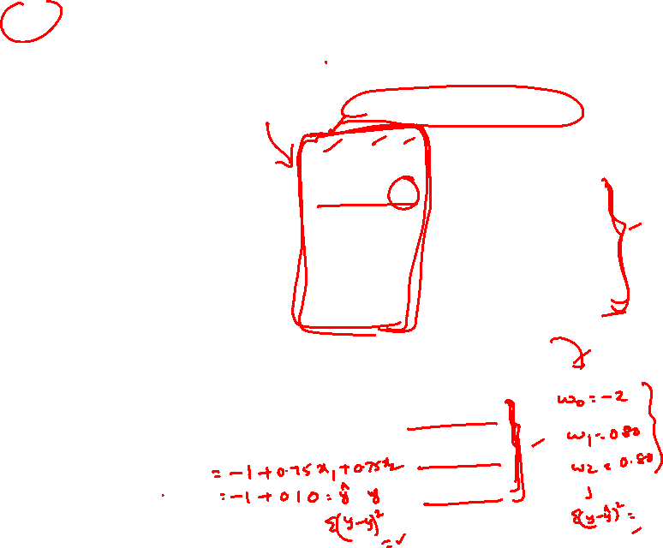
Perceptron for AND gate

Slide 37
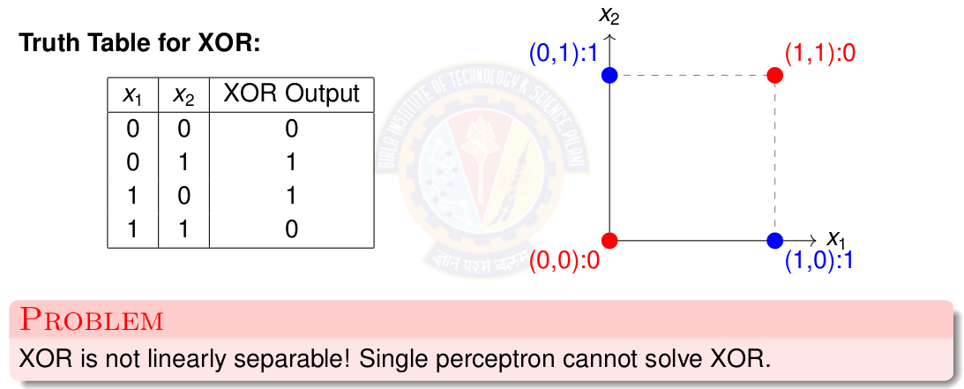
The XOR Problem

Slide 38
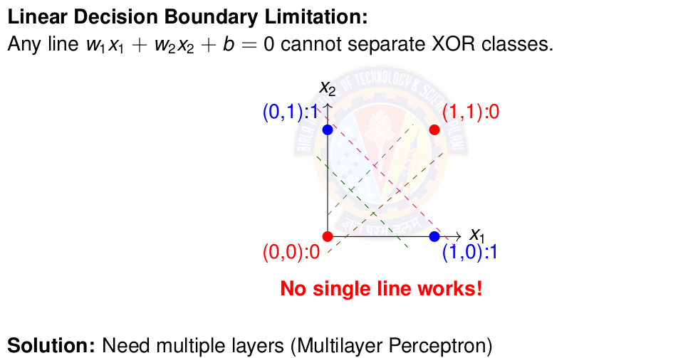
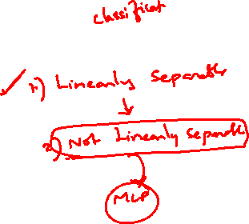
Why Single Perceptron Fails on XOR

Slide 39
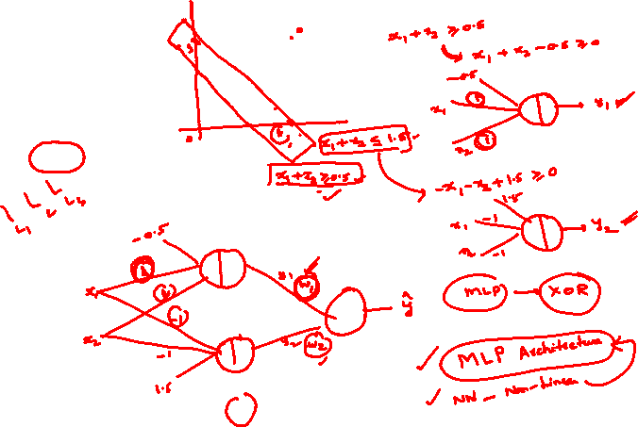
x1 | x2 | y
1 | 1 | 0
0 | 1 | 1
1 | 0 | 1
0 | 0 | 0
XOR

Slide 40
What is Linear Regression?
Definition
Linear regression assumes the output is a linear combination of the input features.
Mathematical Form:
y = w₀ + w₁x₁ + w₂x₂ + · · · + w_{d}x_{d}
where:
x = [x₁, x₂, . . . , x_{d} ]^{T} are the input features
w = [w₁, w₂, . . . , w_{d} ]^{T} are the weights
w₀ is the bias term

Slide 41
Identity Activation Function
Identity Activation Function
Properties of Identity Function
Output: Continuous, (−∞, ∞)
Differentiable everywhere: f '(z) = 1
Allows output to take any real value
Gradient flows unchanged through the neuron
Perfect for predicting continuous targets
Why identity for regression?
Target values are continuous (prices, temperatures, etc.)
Need to predict any real number, not just binary { 0,1 }
Differentiability enables gradient-based optimization
No information loss from input to output

Slide 42
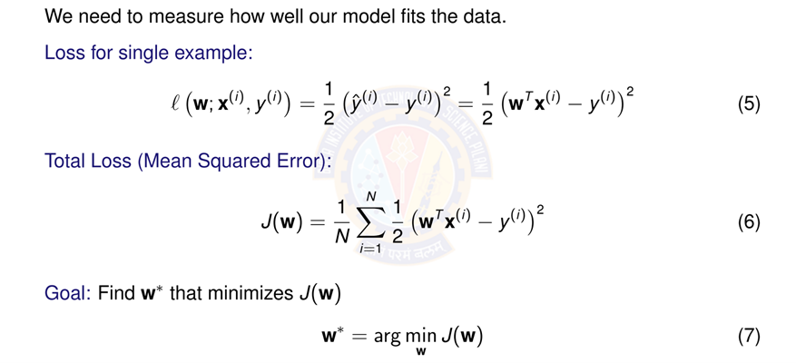
Objective Function: Squared Error Loss

Slide 43
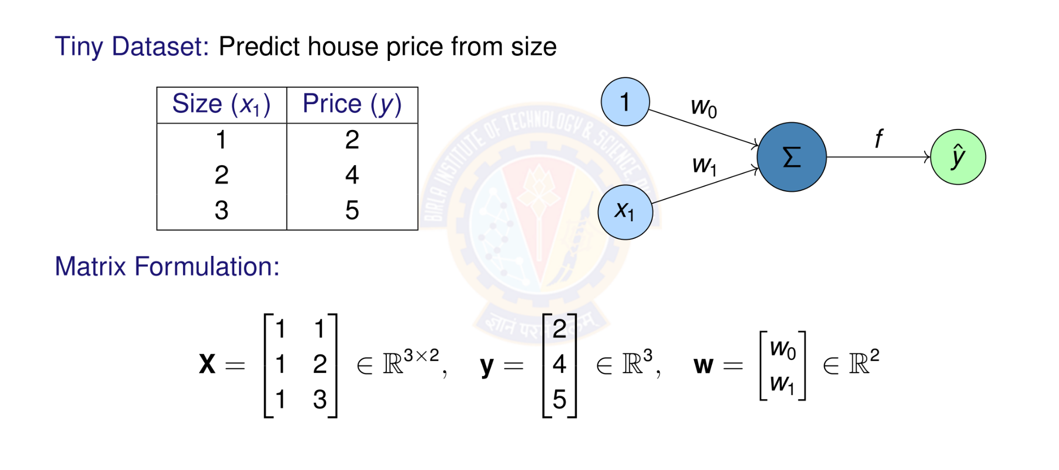
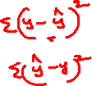
Numerical Example: Setup

Slide 44
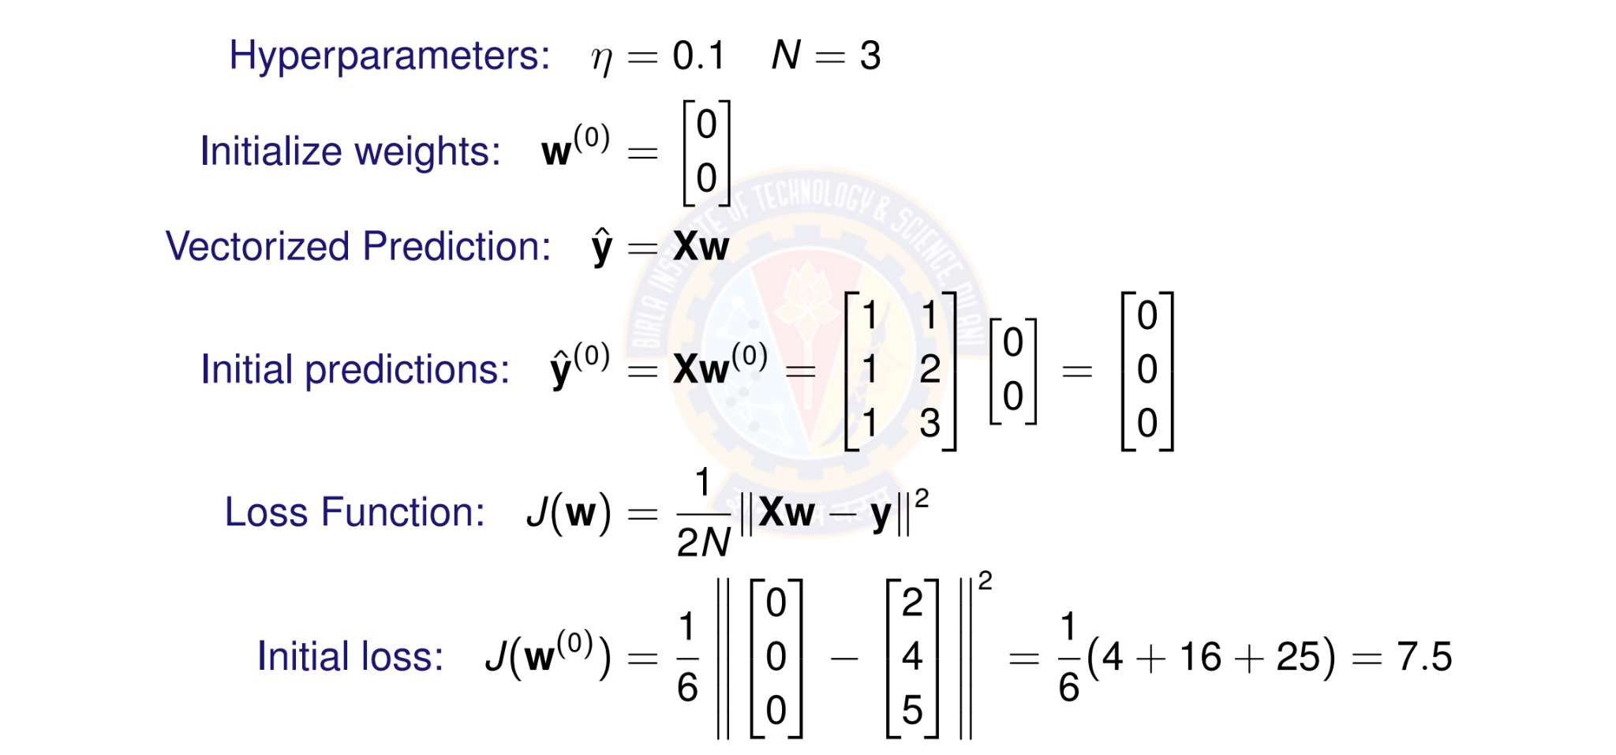
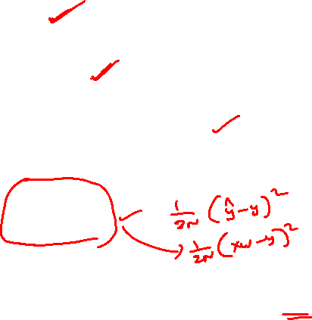
Numerical Example: Initialization

Slide 45
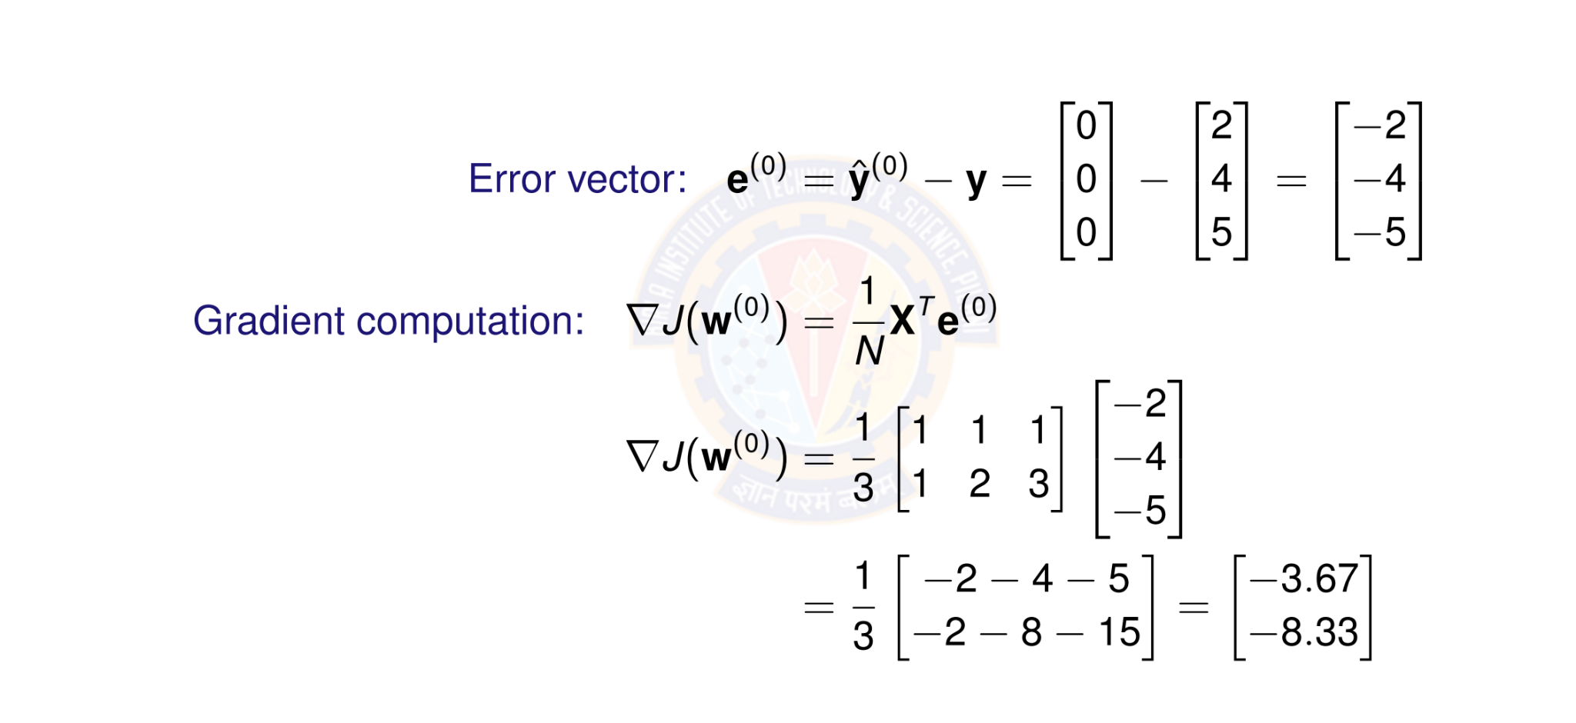

Numerical Example: Computing Gradient

Slide 46
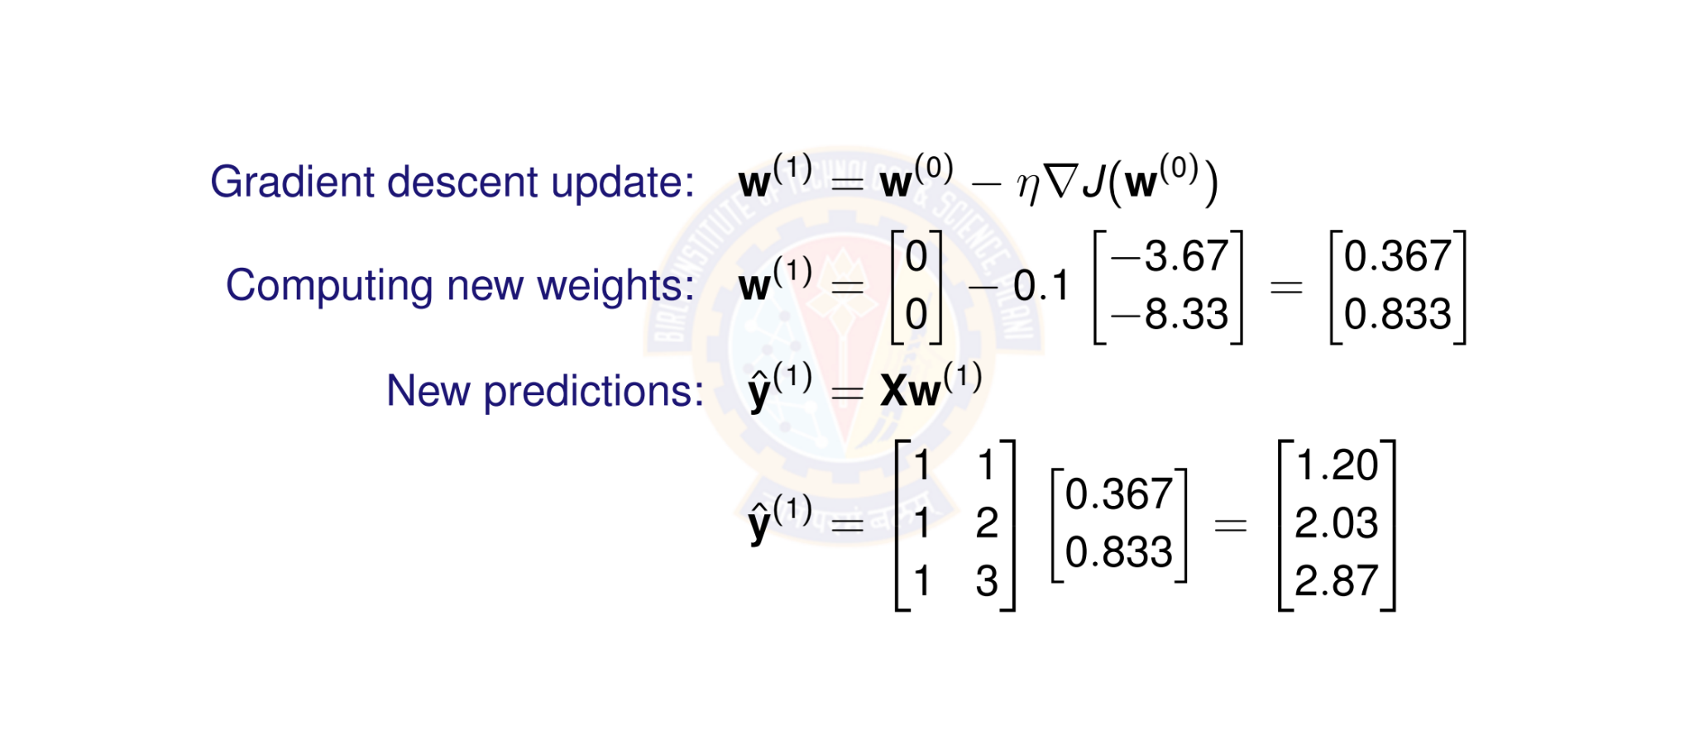
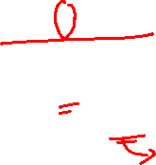
Numerical Example: Weight Update

Slide 47
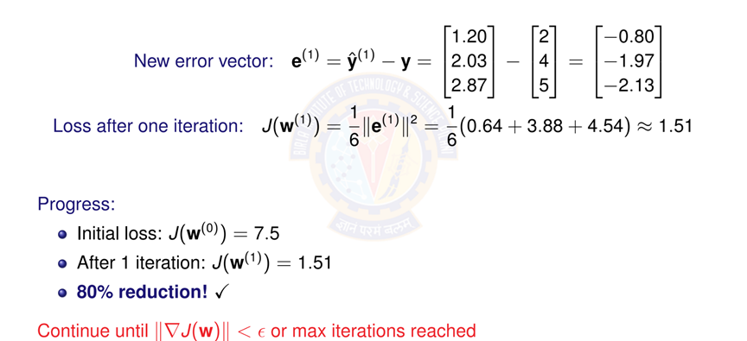
Numerical Example: New Loss

Slide 48
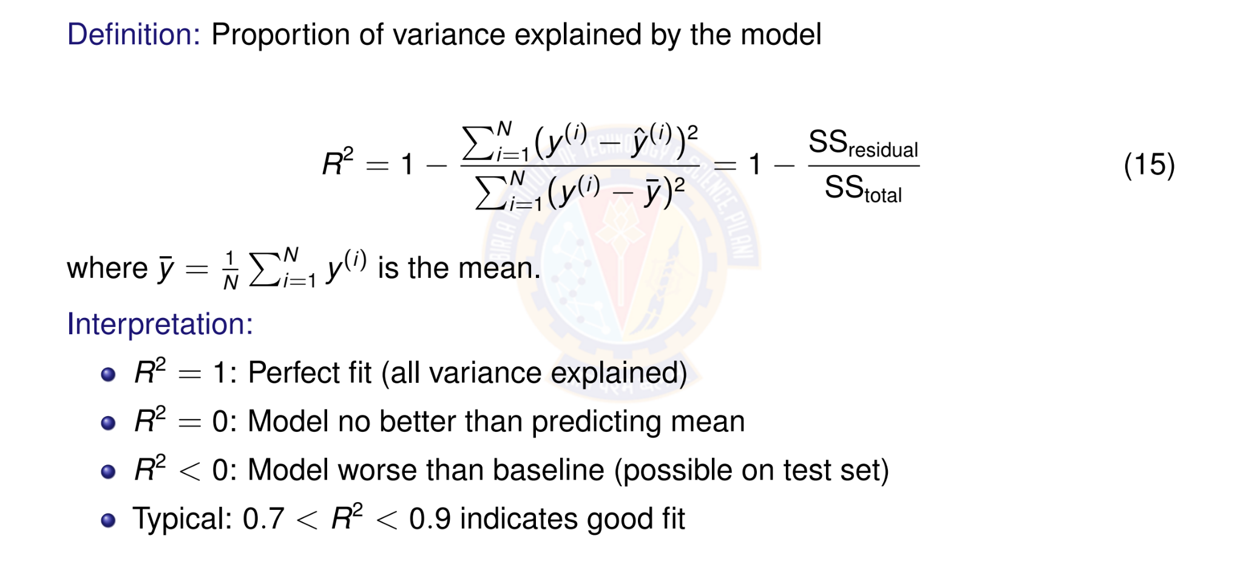
R² Score (Coefficient of Determination)

Slide 49
What is Classification?
Definition
Classification is a supervised learning task that predicts a discrete category or class label based on input features.
Key Characteristics:
Input: Feature vector x ∈ R^{d}
Output: Class label y ∈ {1, 2, . . . , K } (discrete)
Goal: Learn a function f : R^{d} → {1, 2, . . . , K } that assigns inputs to classes
Difference from Regression:
Regression: Predicts continuous values (e.g., price, temperature)
Classification: Predicts discrete categories (e.g., spam/not spam, cat/dog)

Slide 50
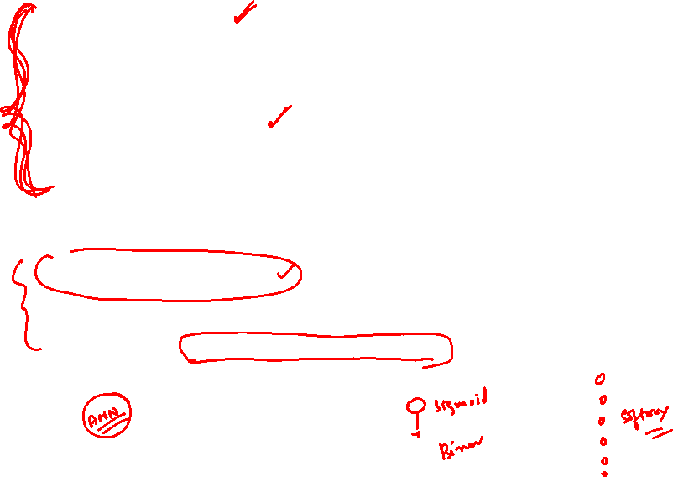
Types of Classification
1.Binary Classification
Two classes: y ∈ {0, 1} or {−1, +1}
Examples: Spam detection, disease diagnosis, fraud detection
2.Multi-class Classification
Multiple classes: y ∈ {1, 2, . . . , K } where K > 2
Examples: Digit recognition (0-9), animal classification
Each example belongs to exactly one class
3.Multi-label Classification
Each example can belong to multiple classes simultaneously
Examples: Movie genres (action + comedy), document tagging

Slide 51
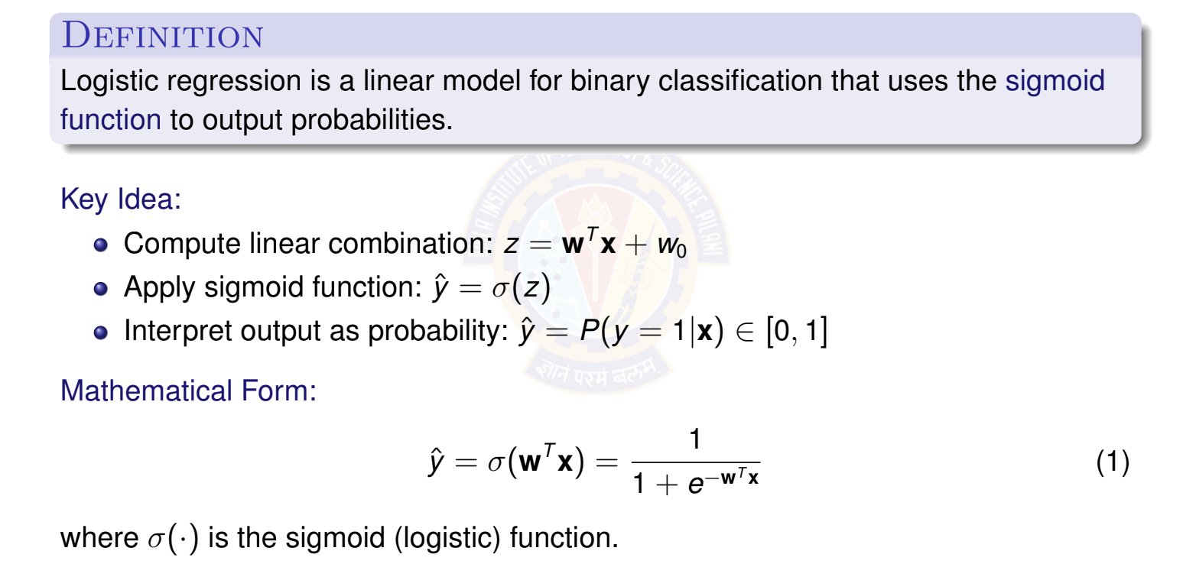
What is Logistic Regression?

Slide 52
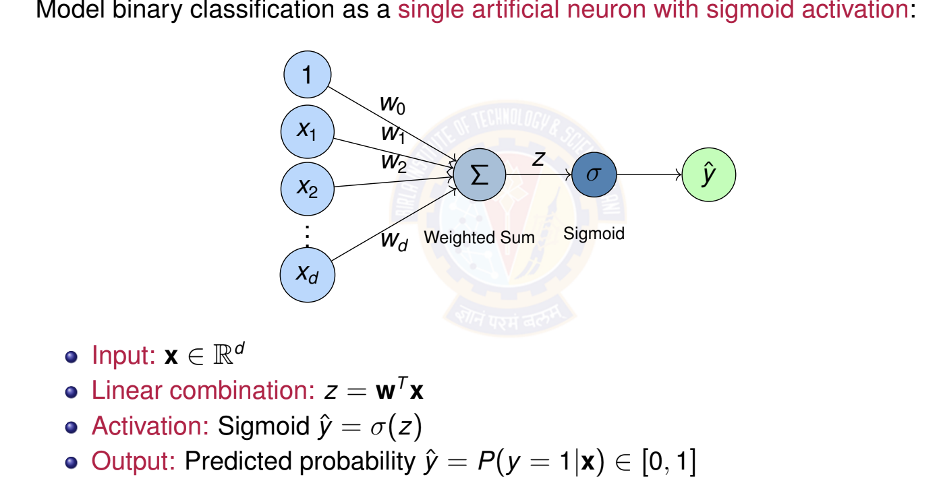
Logistic Regression as a Single Neuron

Slide 53
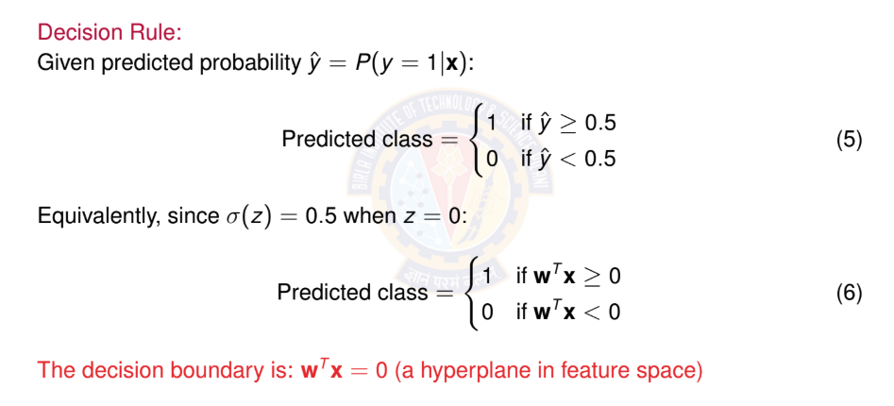
Making Predictions

Slide 54
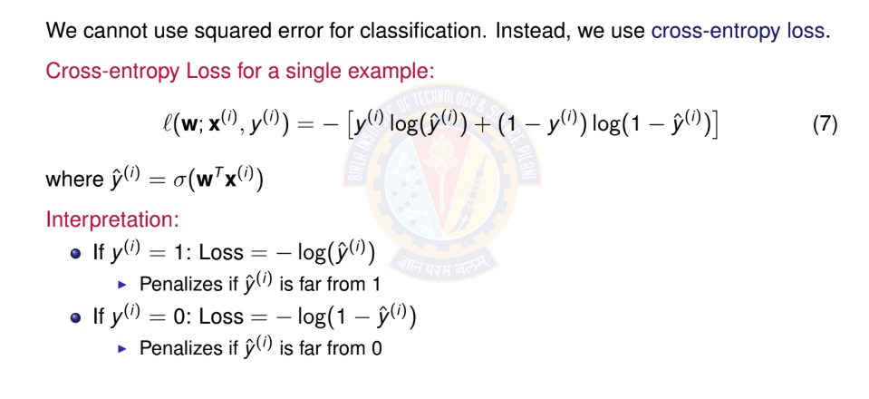
Binary Cross-Entropy Loss

Slide 55
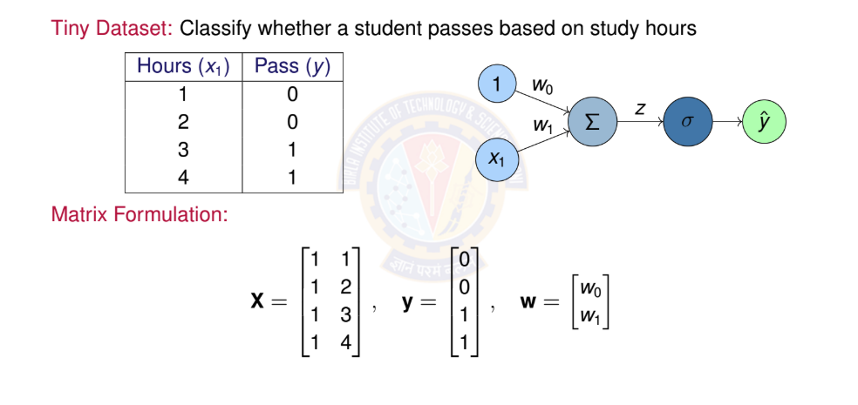

Numerical Example: Setup

Slide 56


Numerical Example: Initialization

Slide 57

Numerical Example: First SGD Iteration

Slide 58


Numerical Example: Second SGD Iteration

Slide 59

Numerical Example: Checking Progress

Slide 60

Confusion Matrix
The confusion matrix shows all prediction outcomes:
Predicted
 | Positive (1) | Negative (0)
Positive (1) | True Positive (TP) | False Negative (FN)
Negative (0) | False Positive (FP) | True Negative (TN)
Actual
Definitions:
TP: Correctly predicted positive
TN: Correctly predicted negative
FP: Incorrectly predicted positive (Type I error)
FN: Incorrectly predicted negative (Type II error)

Slide 61
Classification Metrics I
1. Accuracy: Overall correctness
Accuracy =
TP + TN
TP + TN + FP + FN
(11)
2. Precision: Of predicted positives, how many are correct?
Precision =
TP
(12)
TP + FP
3. Recall (Sensitivity): Of actual positives, how many did we find?
Recall =
TP
(13)
TP + FN
4. F1 Score: Harmonic mean of precision and recall
_{F 1 = 2 ·} Precision × Recall
Precision + Recall
(14)

Slide 62
One-Hot Encoding
Definition: Convert class label to binary vector of length K
For class k : All zeros except 1 at position k
Example with K = 4 classes:
Class 1: y = [1, 0, 0, 0]^{T}
Class 2: y = [0, 1, 0, 0]^{T}
Class 3: y = [0, 0, 1, 0]^{T}
Class 4: y = [0, 0, 0, 1]^{T}
Why one-hot?
Treats all classes equally (no implicit ordering)
Matches the format of softmax output probabilities
Simplifies loss computation
Standard in deep learning frameworks

Slide 63

Multi-class Model Architecture

Slide 64


Softmax Example: Numerical Computation

Slide 65

Numerical Example: Setup

Slide 66

Numerical Example: Data Representation

Slide 67

Numerical Example: First Mini-batch (Examples

Slide 68

Numerical Example: Softmax Computation

Slide 69

Numerical Example: Gradient and Update

Slide 70

Numerical Example: Weight Update

Slide 71

Inference Example

Slide 72
Deep Feed-Forward Neural Network (DFNN)
Definition
A DFNN is a neural network with one or more hidden layers between input and output layers, where information flows forward through non-linear transformations.
Complete system requires four components:
Data: Input features and target outputs
Model: Multi-layer architecture with non-linear activations
Objective Function: Loss function to minimize
Learning Algorithm: Backpropagation with gradient descent
3
4
This is the same framework as linear models, but with added depth and non-linearity!

Slide 73


DFNN Architecture

Slide 74

Layer-wise Computation

Slide 75


Total Parameters in Network

Slide 76


Network Depth vs Width
Two ways to increase model capacity:
Width (more units per layer):
Depth (more layers):
Deep
Wide
Properties:
Hierarchical features
More expressive
Better generalization
Properties:
More parallel features
Higher capacity
Risk of overfitting

Slide 77
Why Depth Matters?
Deep networks learn hierarchical representations:
Simple
Low-level features (edges, textures)
Deep networks can represent exponentially more functions than shallow ones with the same number of parameters!
Mid-level features (parts, shapes)
Complex
High-level features (objects, concepts)
Example: Image classification
Layer 1: Detect edges and colors
Layer 2: Combine into textures and simple shapes
Layer 3: Recognize object parts (eyes, wheels)
Layer 4+: Identify complete objects (faces, cars)

Slide 78

Challenges with Very Deep Networks
Problems that arise with increasing depth:
Vanishing Gradients:
Gradients become exponentially small in early layers
Network fails to learn useful features
Solution: ReLU activations, careful initialization, normalization
Exploding Gradients:
Gradients become exponentially large Causes numerical instability (NaN/Inf values)
Solution: Gradient clipping, proper initialization
Degradation Problem:
Very deep networks harder to optimize
Training error may increase with depth
Solution: Residual connections (ResNets), skip connections

Slide 79
Design Considerations
Key decisions when designing a DFNN:
1.Number of layers L
How deep should the network be?
2.Units per layer n₁, n₂, . . . , n_{L}
How wide should each layer be?
3.Activation functions σ^{(l)}
Which non-linearity for each layer?
4.Output layer design
Depends on task (regression vs classification)
5.Regularization
How to prevent overfitting?
1
3
No universal answer - depends on problem, data, and computational resources!

Slide 80
Numerical Problem : Forward Propagation

Slide 91


Slide 92


Slide 93






Slide 111




